Slide 1
Clicklaw Information Package
This PowerPoint is provided as part of a DIY info package for anyone who would like to provide their audience with a 10-20 minute introduction to Clicklaw.
Anyone can give this presentation without any prior knowledge – a quick look through the notes should familiarize you with the Clicklaw website.
Each slide has notes (see below) with some brief talking points about each slide to aid your presentation.
Please send any feedback or questions to: editor@clicklaw.bc.ca
Notes:
*Note: This slide is read-only. You can remove this slide for your presentation.*

Slide 2
An Overview
Notes:
-Quick overview: Clicklaw is a website, and it is essentially a database of legal resources and services for the everyday person. It’s a way to find answers to everyday legal problems, but specifically for people in B.C. It’s a good starting point if you’re trying to find out what a legal issue is, or to find a person that can help.

Slide 3
A website that aggregates plain language legal information and services for British Columbians
Collaboratively developed, plain language legal publications that are published online in a Wiki platform
Helps public libraries provide current legal information by providing assistance with developing legal collections & training sessions to public librarians
A library with 28 branches to help clients find and use legal information
Notes:
Clicklaw is just one piece of the resources that Courthouse Libraries BC (CLBC) provides for the public. We’ll go through these in more detail, but just to give you an overview…

Slide 4
Notes:
-Clicklaw itself isn’t a publisher of content. You’ll search for something—for example: “cpp” or “adoption”—then get a search result of resources and services that relate to the topic, but they’ll be published by a contributor organization. There are dozens of different trusted organizations in BC, with different types of content expertise and service offerings, that add their resources to Clicklaw.
-These are some examples.

Slide 5
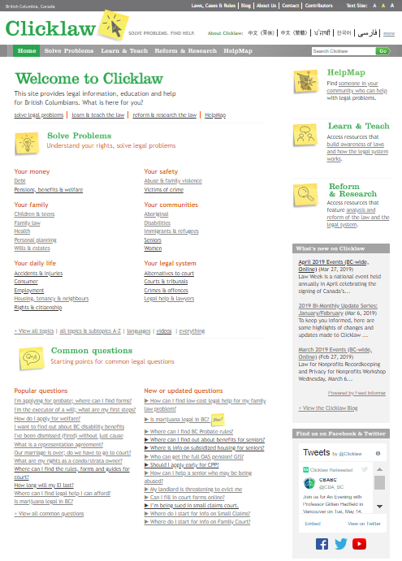
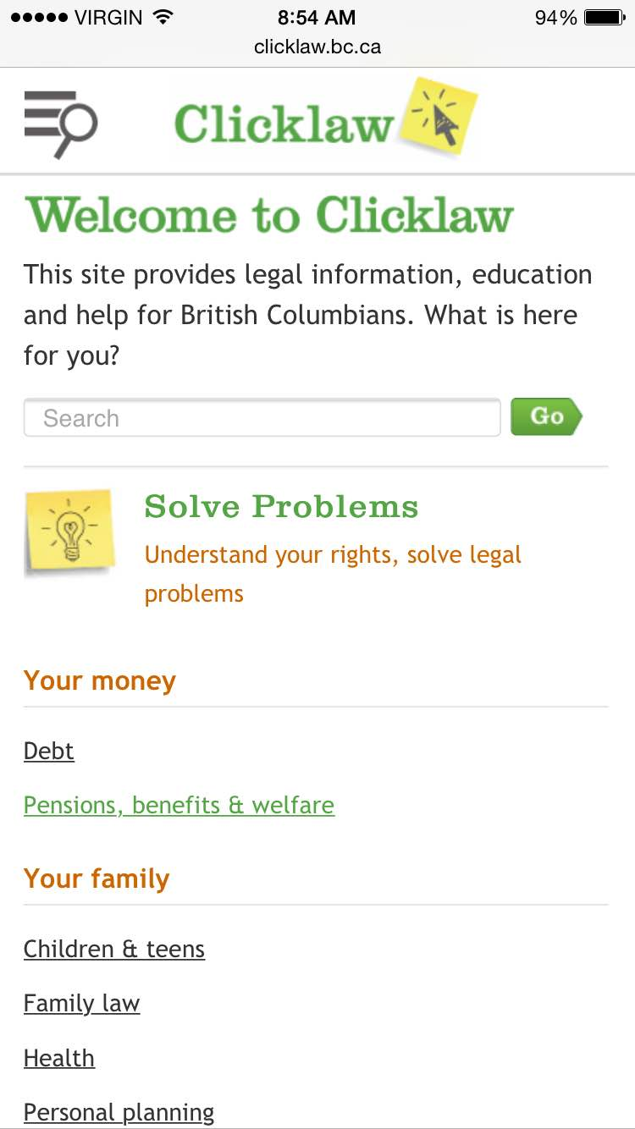
Desktop View
Mobile view
Notes:
-You can view the Clicklaw website on your computer, or mobile phone – anywhere, anytime.
-We’ll be using the desktop version of the site to show examples in the PowerPoint, but please feel free to check it out on your phone! Use the hamburger menu icon in the top left of the screen to open the navigation. -On the desktop site, use the search bar on the to right, or find resources and services by clicking on the topics on the front page. -The Clicklaw topics, or “taxonomy/terminology” is developed with feedback from contributors. It’s language that the public would use to describe their legal issue, rather than legal terminology that a lawyer would use.
-The next slide shows what you see if you search for “employment standards”.

Slide 6
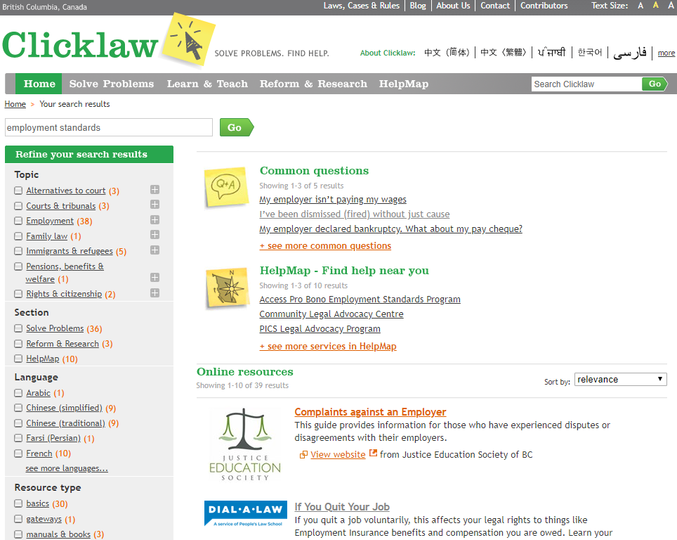
Notes:
-Here is a screenshot of the search results for “employment standards”.
-First you’ll see “Common Questions”. These FAQs are added to as Courthouse Libraries BC frontline staff get asked questions repeatedly about a particular topic. Sometimes new questions are added on the suggestion of a contributor organization. All questions are written in easy to understand, plain language and direct people to good starting places and where to get help. These have been narrowed down to those that relate to “employment standards” – what was entered into the search bar. Let Clicklaw know if you have any suggestions for new questions to add. (Contact info at end of slide) -You’ll also see HelpMap Services. These are clinics, phone lines, workshops, and other services where your client can talk to a real live person about their issue. You can search the HelpMap on its own, but because we’ve searched for “employment standards”, you’ll see only results that relate to that.
-You can click on both the headings and the “+see more” links to see the full list of related results.
-Last but not least, there is a feature that lets you sort resource results by last reviewed date. You can see it in the drop down, along with methods to sort results by most viewed, relevance, and alphabetical order.

Slide 7
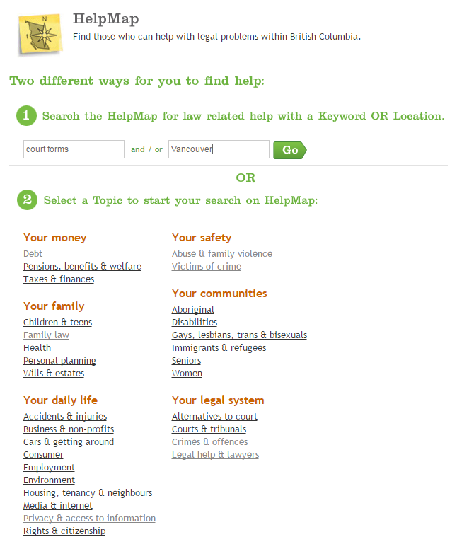
Notes:
-On the previous slide, you saw HelpMap services as part of a search results page.
-You can also search the HelpMap directly if you know you are looking for a help service, by clicking on HelpMap in the header or by navigating directly to clicklaw.bc.ca/helpmap.
-Search the HelpMap directly by using a keyword (e.g. “court forms”) as well as your location (if you type in a city name, the results will only include physical locations in the city/town you search, as well as BC-wide telephone or online services – so by putting in Vancouver, I’ll only get services with physical locations in Vancouver, or those that are offered over the phone or online.) -Or, you can search by a topic. Say you want help with finding out about the PWD benefit, you might click on “Disabilities” under “Your communities” OR, “Pensions, benefits & welfare” under “Your money”.

Slide 8
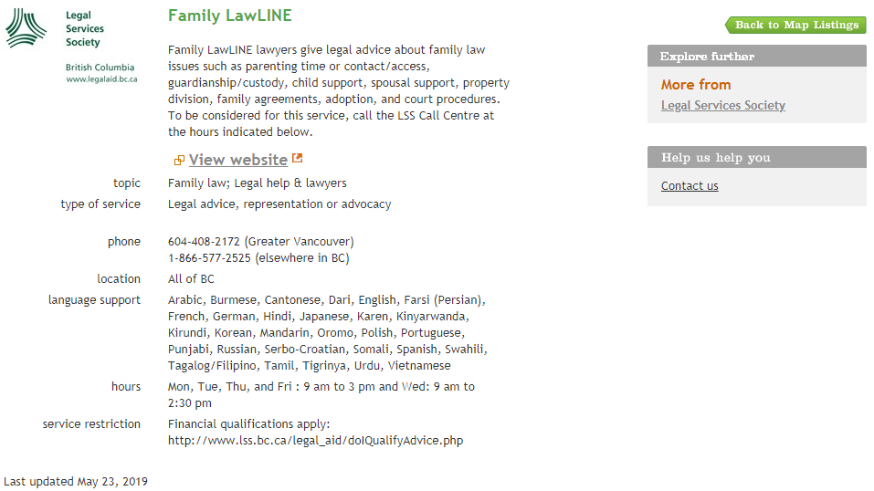
Notes:
-Here’s an example of a service listing you can find on the Clicklaw HelpMap. Family LawLINE is a BC-wide helpline service run by Legal Services Society, where lawyers give legal advice about family law issues like parenting time, guardianship and custody, child support, spousal support, and more. There is language support provided in numerous languages, and financial qualifications apply.

Slide 9
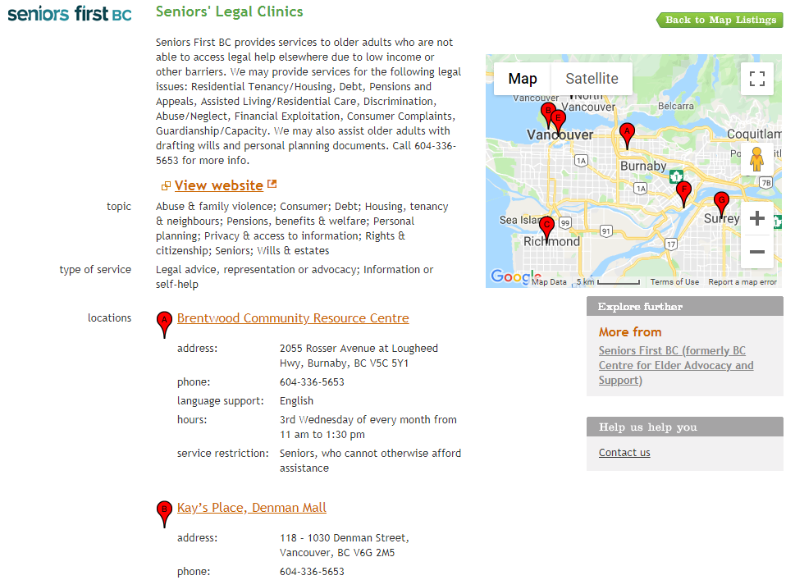
Notes:
-Here’s another example. Seniors’ Legal Clinics is a service provided by Seniors First BC and has several locations in the Lower Mainland. A client can call them to make an appointment in a clinic near where they live.

Slide 10
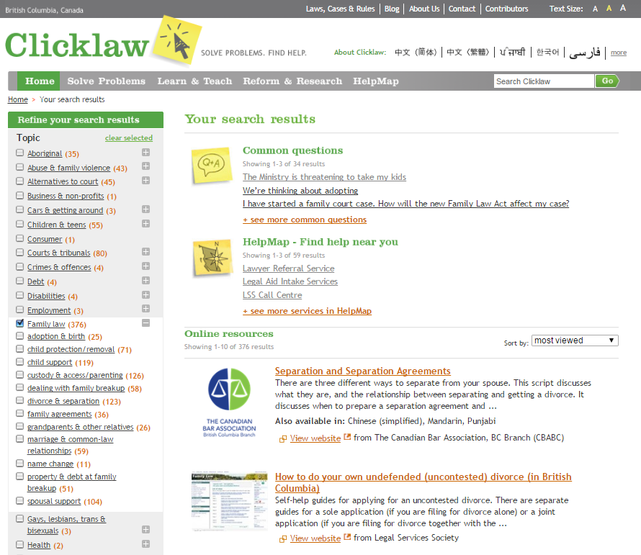
Notes:
-Sometimes your search might turn up many more results than you were looking for. On most search result pages you will see a “Refine” column to the left (this feature is not available on mobile). This will let you further narrow down your search results. You can select subtopics, languages, multiple topics, and more (e.g. You might select both “Alternatives to court” and “Family Law”, for example, if you were looking for family law mediation resources).

Slide 11
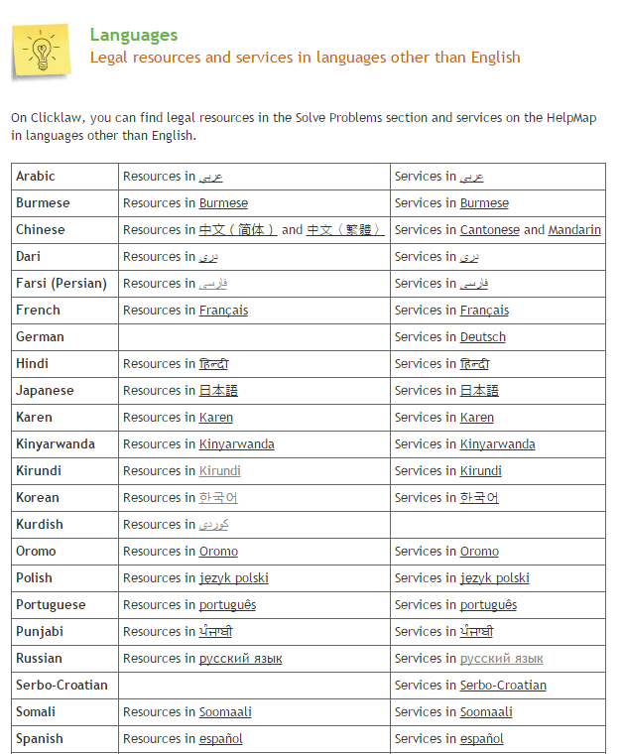
Notes:
-While you will need the help of someone who speaks English to navigate the site, if you are helping someone who is more comfortable with reading resources or receiving help in another language, you can navigate to the “Languages Other than English” page by clicking on “more” in the header to find quick links to resources and services in each available language.

Slide 12
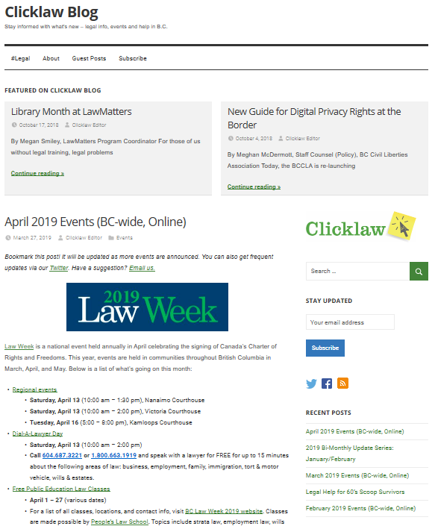
Notes:
-How do you stay updated with legal info when there’s so much new and updated info all the time? Everyone relies on word of mouth. One great and easy way is to sign up for the Clicklaw blog mailing list.
-The blog is growing and subscribed to by legal intermediaries, lawyers, and community workers around the province as well as journalists.
-If you subscribe, you will get notified about events, webinar and in-person training opportunities, new resources and services, and more!
-Clicklaw is also on Facebook and Twitter as @Clicklaw, so if you’re active on either platform, please follow and like away!

Slide 13
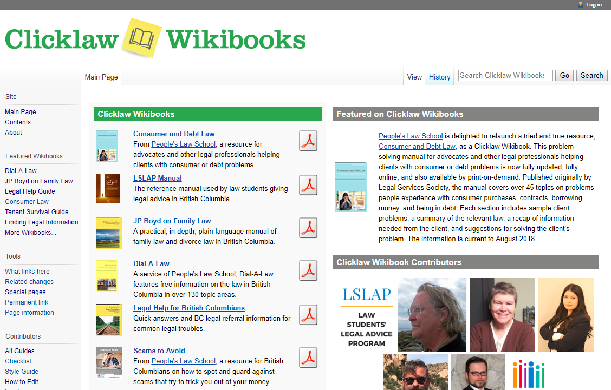
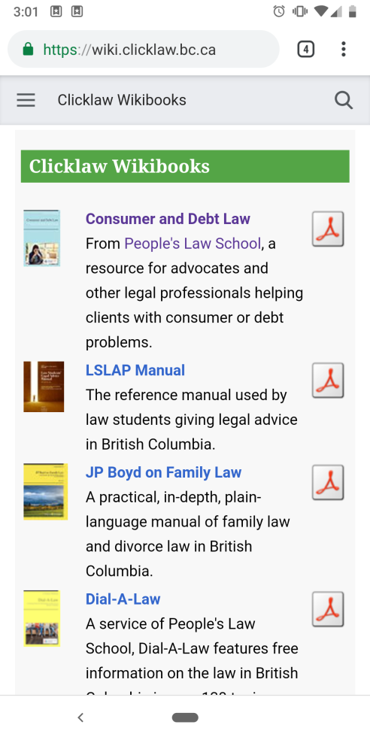
Desktop View
Mobile view
Notes:
-If you’re dealing with a family law issue, workplace bullying and harassment, being an executor, or more, don’t forget to check out the Clicklaw Wikibooks (you can get to them through the footer on the Clicklaw website, and each Wikibook title is listed as a resource on Clicklaw).
-To explain the Wikibooks…If Clicklaw is akin to Google for BC public legal information (e.g. a way to search a directory of different legal resources and services in BC), the Clicklaw Wikibooks is the wikipedia counterpart. It contains “wikibooks” or groupings of wiki pages by topic. Its most popular title is JP Boyd on Family Law, which is a practical, in-depth, plain-language manual of family law and divorce law in British Columbia.

Slide 14
Notes:
-The Clicklaw Wikibooks platform continues to grow with new & revised titles.
-You can see on our screen a new wikibook from People’s Law School and a revised, 2019 edition of the popular Tenant Survival Guide from TRAC. -How to hear about when these new titles launch? Subscribe to the Clicklaw blog!

Slide 15
Questions?
editor@clicklaw.bc.ca
@Clicklaw
Notes:
-So to recap, you can use Clicklaw, and the Clicklaw Wikibooks to find trusted, current legal information and services in BC. Information is maintained by contributor organizations, lawyers, and the Clicklaw editorial team. -Now, you should be able to describe different ways to search for legal info and help on Clicklaw and the HelpMap, stay up to date on changes, and know how to contact Clicklaw with feedback, comments and questions.
*Note: Please feel free to input your name & organization in the footer – or leave blank Invite questions and feedback – if you can’t find or don’t know the answer, just say that and ask if we can follow up with them*

